Slide 1
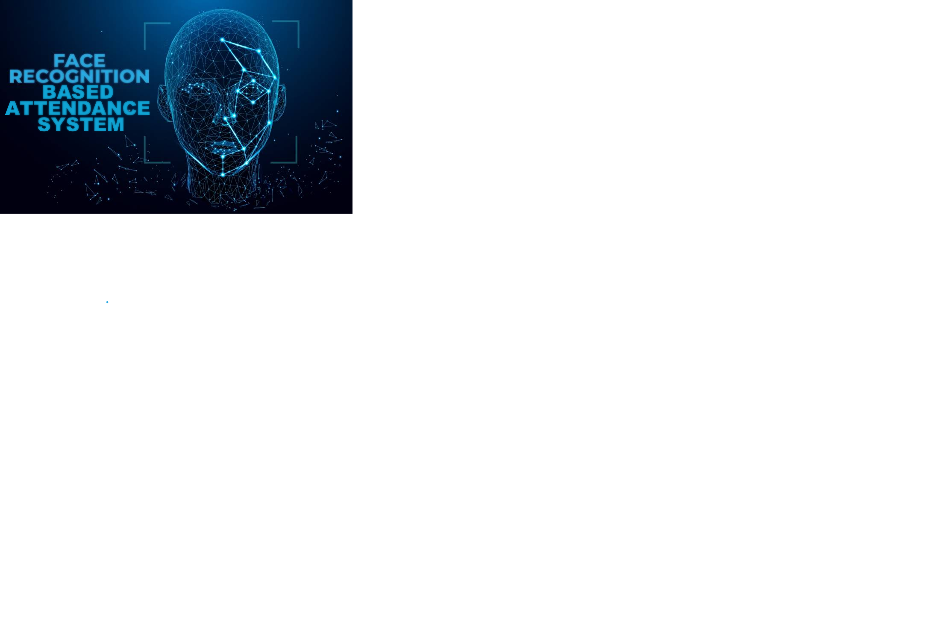

Slide 2
Introduction
Face recognition system is a type of biometric method which is capable of identifying or verifying a person from a digital image or a video frame from a video source. There are multiple methods where face recognition work and identification of individuals in an organization for the purpose of attendance is one such method of face recognition since, maintenance and monitoring of attendance records plays a vital role in the analysis of performance of any organization. The purpose of developing attendance management system is to computerize the traditional way of taking attendance. Automated Attendance Management System performs the daily activities of attendance marking and analysis with reduced human intervention as with one click of a mouse button the attendance can be taken and can be represented in an excel sheet form.​

Slide 3
How the system works
Image Capture
Face Detection
Pre processing
Feature Extraction
Feature Matching
Feature Recognition
Collection of Student Data
Feature Extraction
Face Features & Student ID Database
Update the Attendance

Slide 4
Face Detection
Process of identifying and locating all the present faces in a single image or video regardless of their position, scale, orientation, age and expression.
Face Detection which can categorised
Feature-based (locate faces by extracting structural features of the face)
Appearance-based
Knowledge-based (Based on set of rules)
Template matching (uses pre-defined or parameterised face templates to locate or detect the faces)

Slide 5
How Face Detection Works
The face detection work as to detect multiple faces in an image.
Firstly picture is transformed from RGB to Grayscale because it is easy to detect faces in the grayscale.
After that, the image manipulation used, in which the resizing, cropping, blurring and sharpening of the images done if needed.
The next step is to use Haar-Like features algorithm, used for finding the location of the human faces in a frame or image.

Slide 6
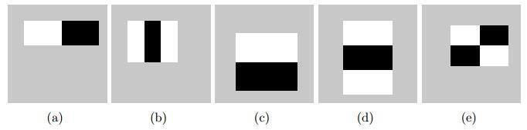

The haar-like algorithm is also used for feature selection for an object in an image
All these features are then extracted and stored in the form of matrix.
Further operations are performed like:
Integral Image Calculation
Applying Adaboost (strong classifier and weak classifier)

Slide 7
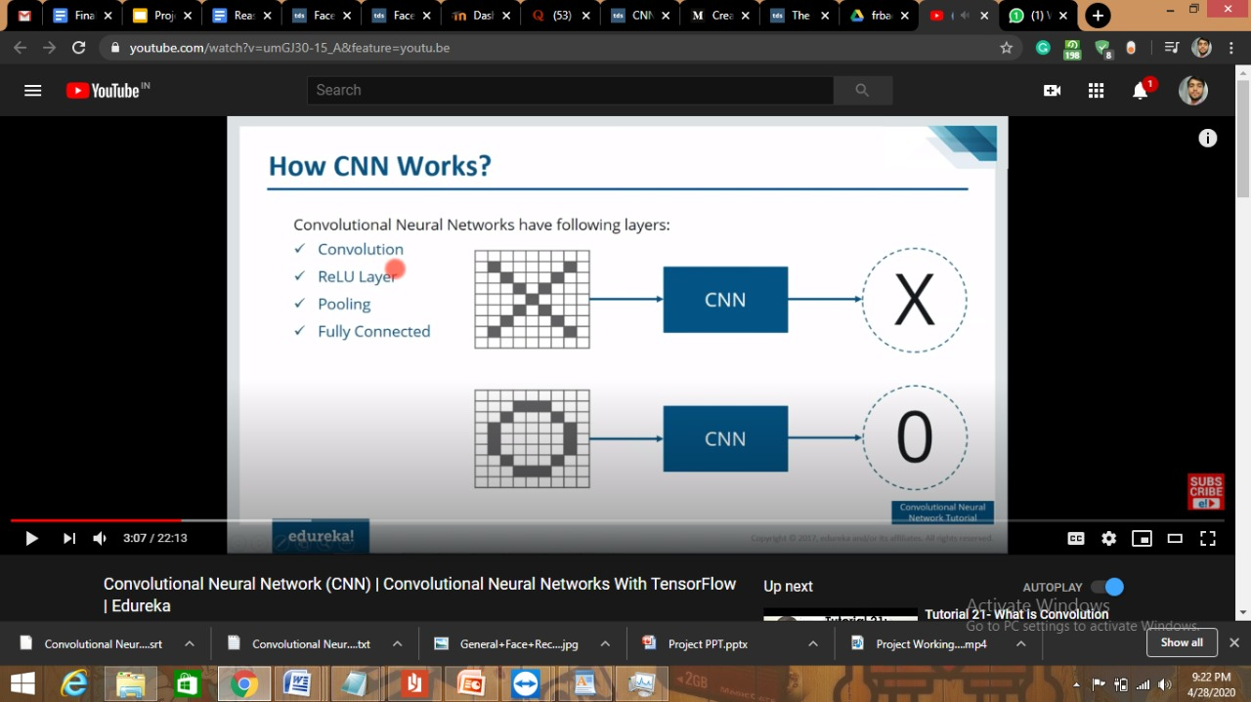
Face Recognition
Recognition is based on the concept Convolution Neural Network(CNN)
CNN have basically four layers
Convolution
ReLU Layer (Activation Function)
Pooling
Fully Connected

Slide 8
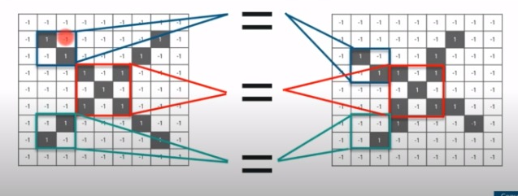
How Face Recognition Works
Let suppose we have two images one is deformed and one is proper image.
With the help of CNN we take small part (feature) from both the images and matches those parts which looks identical and use them as filter.

Slide 9
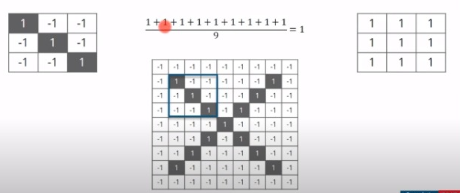
Steps involved in various layers:
Convolution Layer:
Line up the feature and image patch of default image and multiply each image pixel by the corresponding feature pixel
Sum it up and divide it by total pixels in the feature

Slide 10
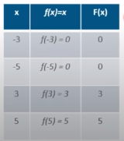
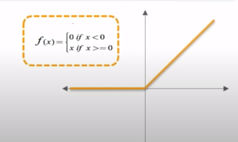
2) ReLU Layer:
It is an activation function.
It helps us to deduce those negative values or to obtain values above than certain threshold.

Slide 11
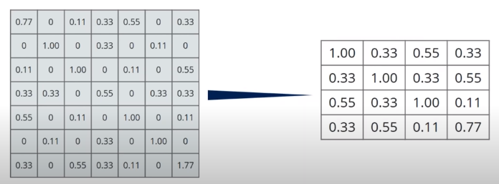
3) Pooling
In this layer we shrink the image stack to a smaller size
For example:
Let’s suppose we have this matrix which we got from ReLU layer and we will select maximum value from each stack( taking window size 2X2 ) and save it in another matrix which will reduce the size.

Slide 12
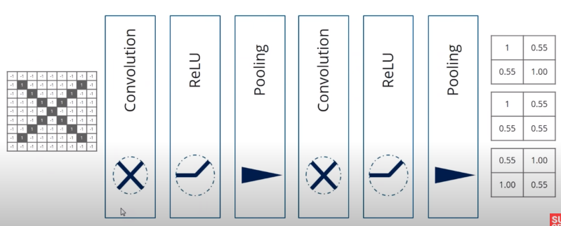

Slide 13
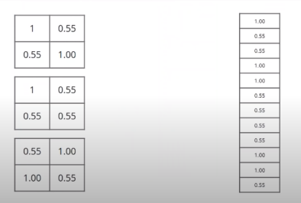
4) Fully Connected Layer:
This is the final layer where actual classification happens.
Here we take our matrix and put them into a single list which is used to match by using Hign and Low’s to recognize a particular image

Slide 14
Technology Used
Python 3.7
Dlib
Openpyxl
OpenCV

Slide 15

Working Video

Slide 16
THANK YOU

